Slide 1
CS 2600 Computer Networks I Dr. Sayeed Sajal Chapter 1: Foundation Lecture 2

Slide 2
Slide 2
A computer network is the infrastructure that provides communication between computers.
– Dave Heldenbrand (1954 - ?)

Slide 3
A Brief History of Computer Networks
Began in the 1960’s as direct connections between terminals and a central mainframe (“host”) computer, using wires or phone lines (with modems)
1970’s – host computers were being interconnected by “high-speed” (56Kbps!) analog phone lines and satellite links, creating interstate or international Wide Area Networks (WANs)
1980’s – Local Area Networks (LANs) emerged with the PC, providing true high speed connections to nearby minicomputer and microcomputer servers (typically less than a mile apart)
1990’s – the Internet matures, voice, graphics, video and other “multimedia” data are transported and stored in digital form
2000’s – wireless (WiFi) LANs begin to dominate, the laptop rules, broadband connections come to the home, global Internet access for the masses
2010’s – the age of wide area mobile computing with smartphones, 4G LTE cellular networks, voice becomes data, UN declares Internet access a basic human right

Slide 4
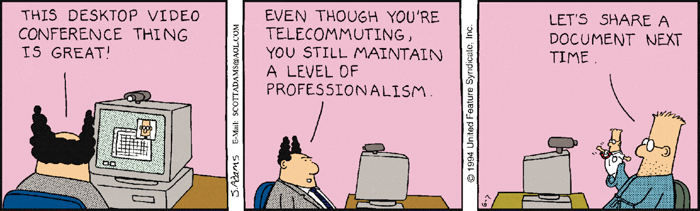
Creative Uses for Multimedia Networks
https://dilbert.com/strip/1994-06-07

Slide 5
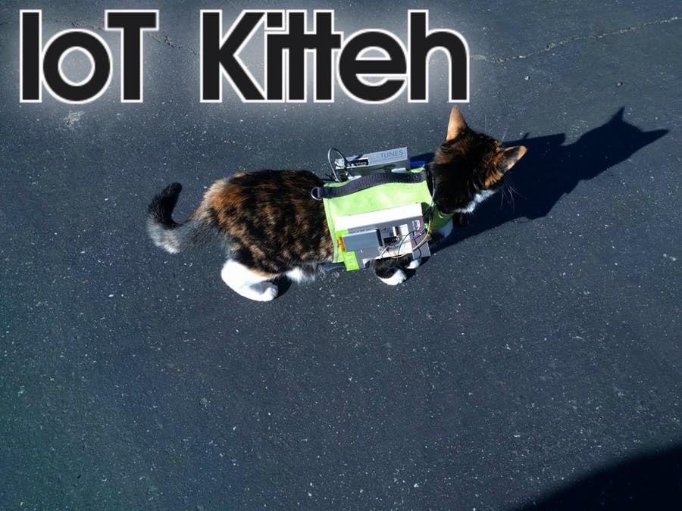
Fooling the Feds
https://www.hackster.io/jeremywall/iot-kitteh-df0341

Slide 6
Slide 6
The Internet is the global network of interconnected networks (“inter-net”) that connects many different types of computers and other devices.

Slide 7
Networking-Related Job Titles
Network Architects and Engineers design networks
Network Programmers develop network operating systems, utility software and network-based applications
Network Administrators are responsible for the day-to-day management of networks
DevOps (Development Operations) experts are involved in delivering (updating, testing and securing) web-based software updates, along with and managing the cloud-based server platforms that they typically run on
Cyber Security experts focus on security infrastructure, including both in-house networks and cloud-based systems
There’s often overlap between these different jobs
Other related jobs include trainer, sales support engineer, technical support staff, project management, product management, product marketing, etc.

Slide 8
“First Generation” Network Applications (Pre-1990)
Mostly government and academic users
Military command & control
Email (1982)
Remote terminal login using TELNET etc. (1982)
File Transfer Protocol (1980)
Newsgroups and Usenet (1980)
For consumers…
Automated Teller Machines (1960’s)
1980’s dial-up systems (Bulletin Boards, CompuServe)

Slide 9
“Second Generation” Network Applications (1990-2000)
The Internet is accessible from home and office, and available outside the U.S.
Worldwide Web
E-commerce (enabled by Web services & TLS/HTTPS security)
Online games
Instant messaging
Early peer-to-peer (P2P)

Slide 10
Current Network Applications
The mobile multimedia and (not very) secure Internet
Streaming video (Netflix, etc.)
Videoconferencing (commercial, Skype, etc.)
Voice (Voice over IP)
Web-enabled applications
MMOG games
Mobile apps for smartphones & tablets
Social networks

Slide 11
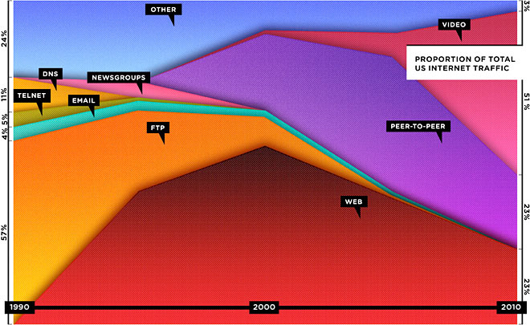
Proportion of Internet Traffic by Application (1990 - 2010)
Wired magazine Sept. 2010

Slide 12
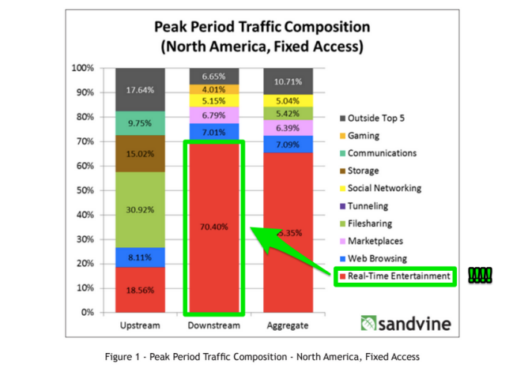
Some Newer Numbers (Non-mobile, as of December 2016)
https://finance.yahoo.com/news/more-70-internet-traffic-during-161403930.html

Slide 13
The Dual Meanings of “Connectivity”
1. The ability to communicate, as in “We’ve lost connectivity because our DSL link is down”.
2. The quality of communication, as in “The connectivity on my iPhone is lousy in Price – with Edge instead of 4G, it takes forever to download my email”.

Slide 14
Scalability
The ability to grow “gracefully”, without having to do major redesign or replacement of existing components or (worse yet) having to rebuild from scratch.

Slide 15
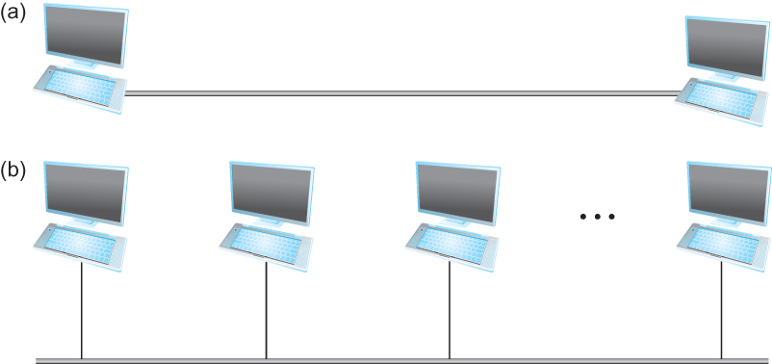
Figure 1.2 Direct Links: (a) Point-to-Point; (b) Multiple-access*
nodes
links (media)
*In the slides, some figures from the text have been enhanced with additional detail

Slide 16
Point-to-Point Connections with Multiple Nodes
The number of two-way point-to-point links l needed to provide direct connectivity between n nodes is:
l = n (n-1)
2

Slide 17
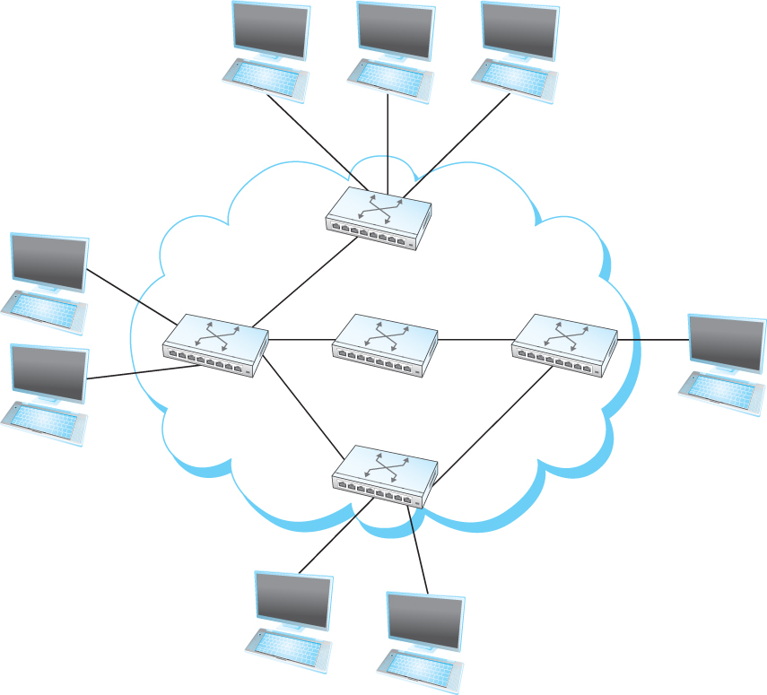
Figure 1.3 Switched Network
cloud symbol - “some
sort of network”
internal nodes (switches)
external nodes (hosts)

Slide 18
Two Models for Switched Networks
Traditional circuit-switched networks establish a complete end-to-end circuit before communicating (like the telephone network 50 years ago)
Packet-switched networks use a “store-and-forward” process to relay digital messages (packets) from one node to the next, until the message is delivered
The original sender is usually called the source
The ultimate recipient is called the receiver (or the sink)
Today, it’s pretty much a packet switching world

Slide 19
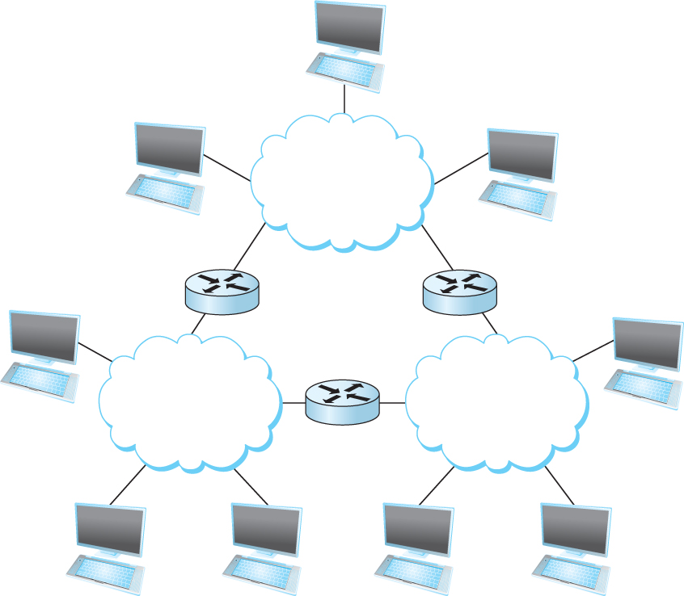

Figure 1.4 Interconnection of Networks (an internet)
Switches
Routers
Routers connect networks to other networks
Switches connect nodes within a single network

Slide 20
Original Inspiration for Internet Architecture
Wallace
sheep
From “A Close Shave”, Aardman Animations Ltd. (aka “Wallace & Gromit”)

